Slide 1

Scrum Agile Approach
Brandon Hamilton
CS-250

Slide 2
Roles of a Scrum-agile Team
Developers
“Creates the products value”
Designs, implements, and tests the product
Works the back log
Interpret user stories
Self organize tasks
Cross functional skills
Scrum Master
“Ensures agile theory is applied to the project”
Mentors team in Scrum agile methodology
Promotes communication and collaboration
Clears obstacles or distractions
Handles disputes or behaviors.
Helps define value
Product owner
“Ensures the value of the product”
Speaks for customer or outsiders involved
Manage the back log
Defines user stories
Keeps team on schedule

Slide 3
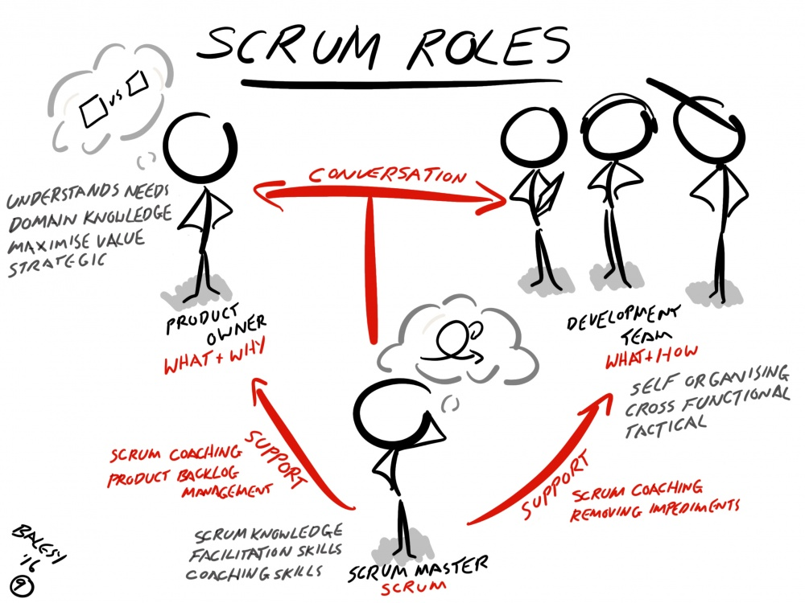


Slide 4


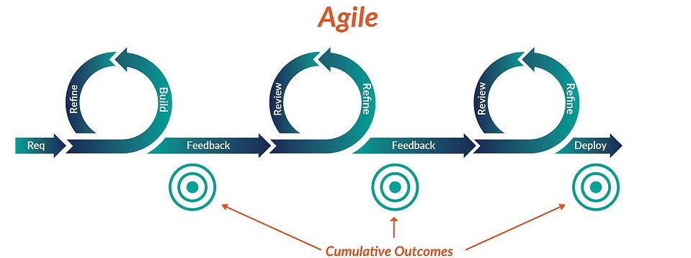
Planning – What are we creating , who it will be for and what value will it bring
Requirement Analysis- what is needed to create product including: system, software, skills, knowledge
Design – plan out the product architecture based on: specifications time, budget, risk, user base.
Implementation – tasks are broken up and worked on by developers
Testing – requirements are compared against code performing test cases
Deployment – First deployment or beta given to customer for testing and feedback
Maintenance – any unforeseen problems or improvements are assessed

Slide 5

Water Fall Experience
Waterfall is a more rigid development model
Less customer involvement throughout
Changes are not made until the end of development
Increased risk of wasted effort
We would have had to relaunch travel site as a travel rehabilitation vacation site after launching it as a top vacation destinations site.
Infrequent customer interaction
Customer interaction is done at planning an maintenance phase at beginning and end.

Slide 6
WHEN TO CHOOSE :
Waterfall
Agile
Is the process or product fixed?
is there strict requirements?
strict timeline?
Enhancing an older system?
A very large project with strict requirements?
What processes are in place to catch any unforeseeable changes?
Do you want room for creativity?
Is customer involvement important ?
Less strict timeline and budget
Flexible development lifecycle

Slide 7

References:
7T - SevenTablets, Inc. 2021. What is the Agile SDLC Model? - Phases and Methodology | 7T - SevenTablets, Inc.. [online] Available at: <https://7t.co/blog/what-is-the-agile-sdlc-model-phases-and-methodology/> [Accessed 23 August 2021]
Resources.scrumalliance.org. 2021. The Scrum Team Roles and Accountabilities [0 SEU]. [online] Available at: <https://resources.scrumalliance.org/Article/scrum-team> [Accessed 23 August 2021].
Agileme.com.au. 2021. Scrum Roles - AgileMe. [online] Available at: <http://www.agileme.com.au/wiki/Scrum_Roles> [Accessed 23 August 2021].
Macadamian. 2021. When to Use Waterfall vs. Agile | Macadamian. [online] Available at: <https://www.macadamian.com/learn/when-to-use-waterfall-vs-agile/> [Accessed 23 August 2021].
Unsplash.com. 2021. Photo by Slidebean on Unsplash. [online] Available at: <https://unsplash.com/photos/Kk6cQ6iYbw4> [Accessed 23 August 2021].

